Slide 1
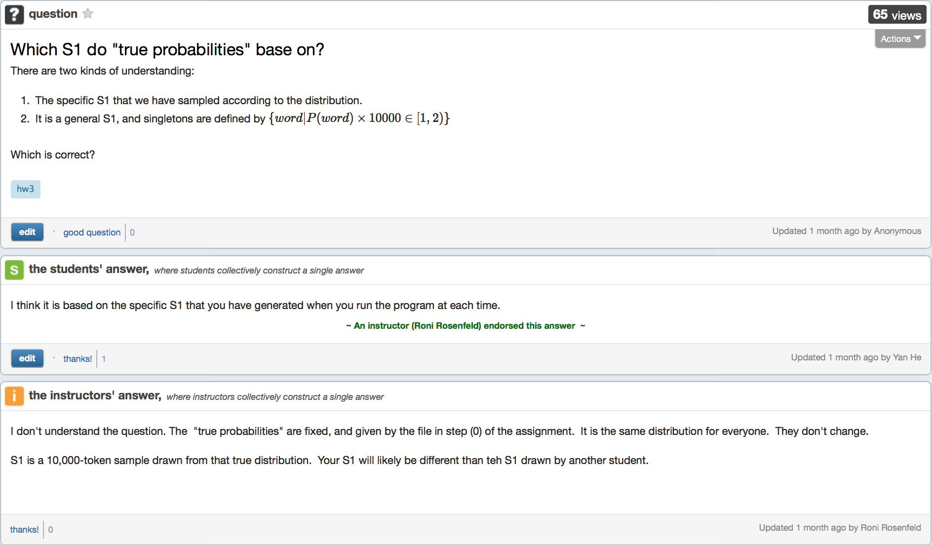
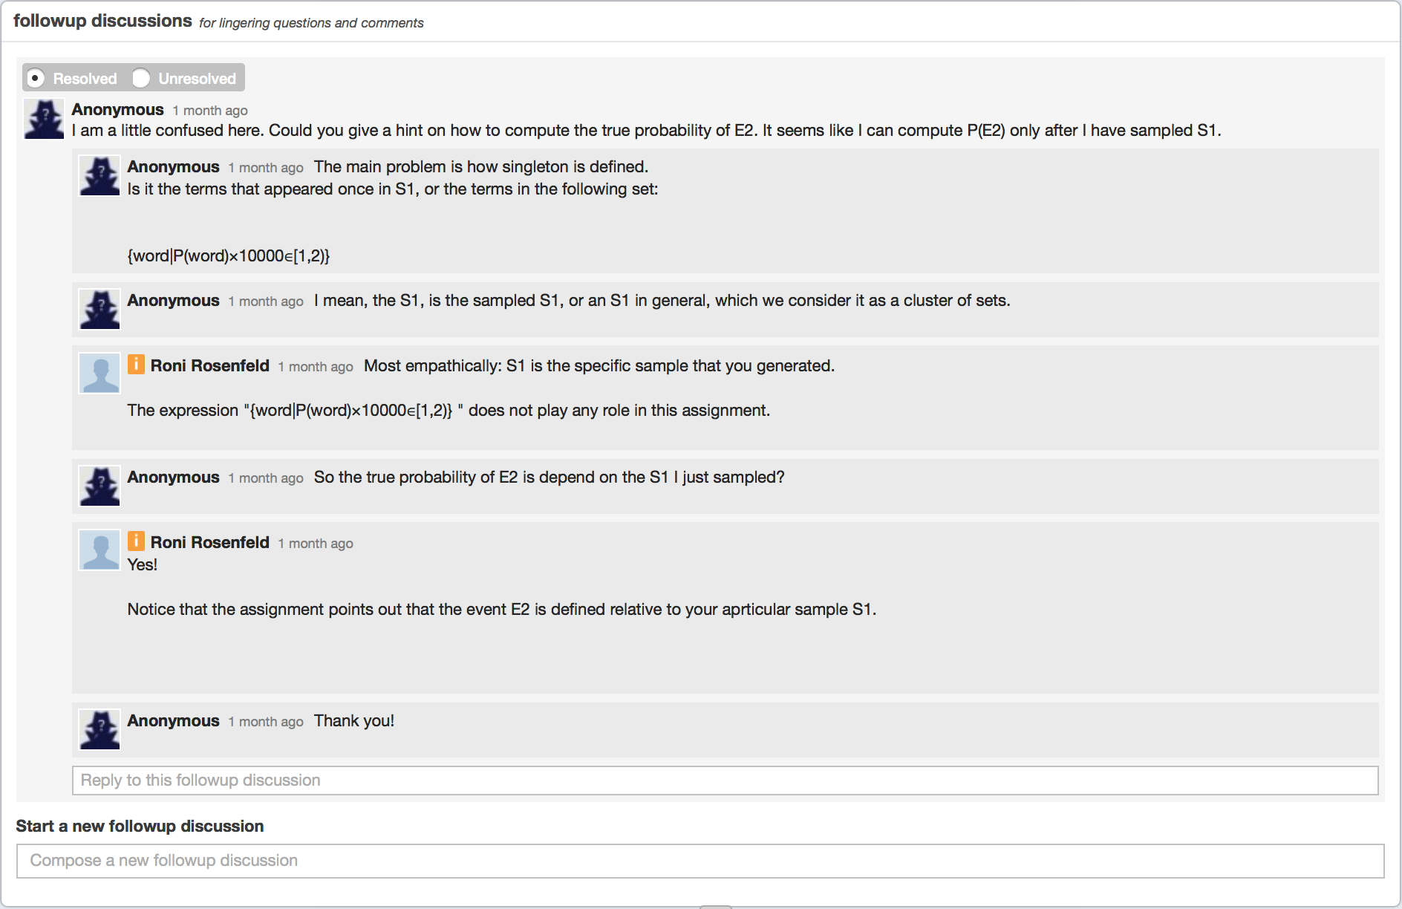
2d
2c
2e
2g
2g
2f
2h
2j
2i
1b

Slide 2
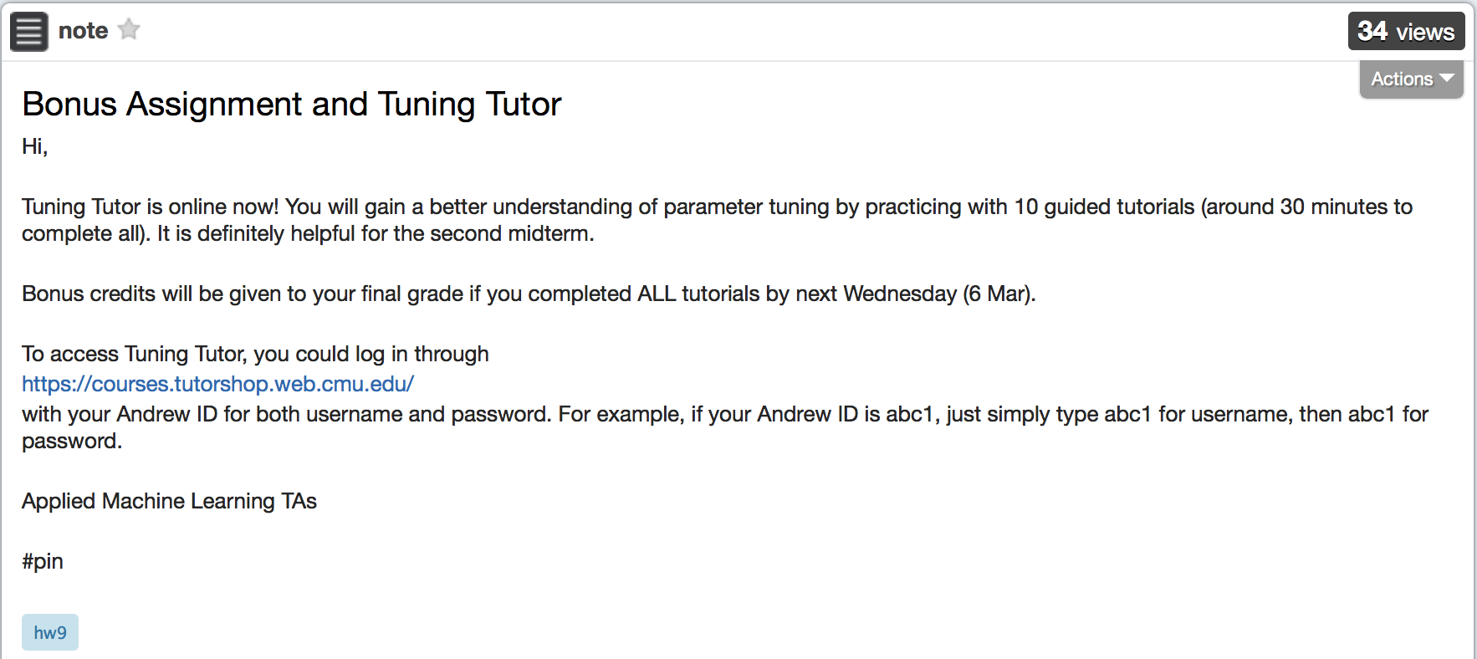
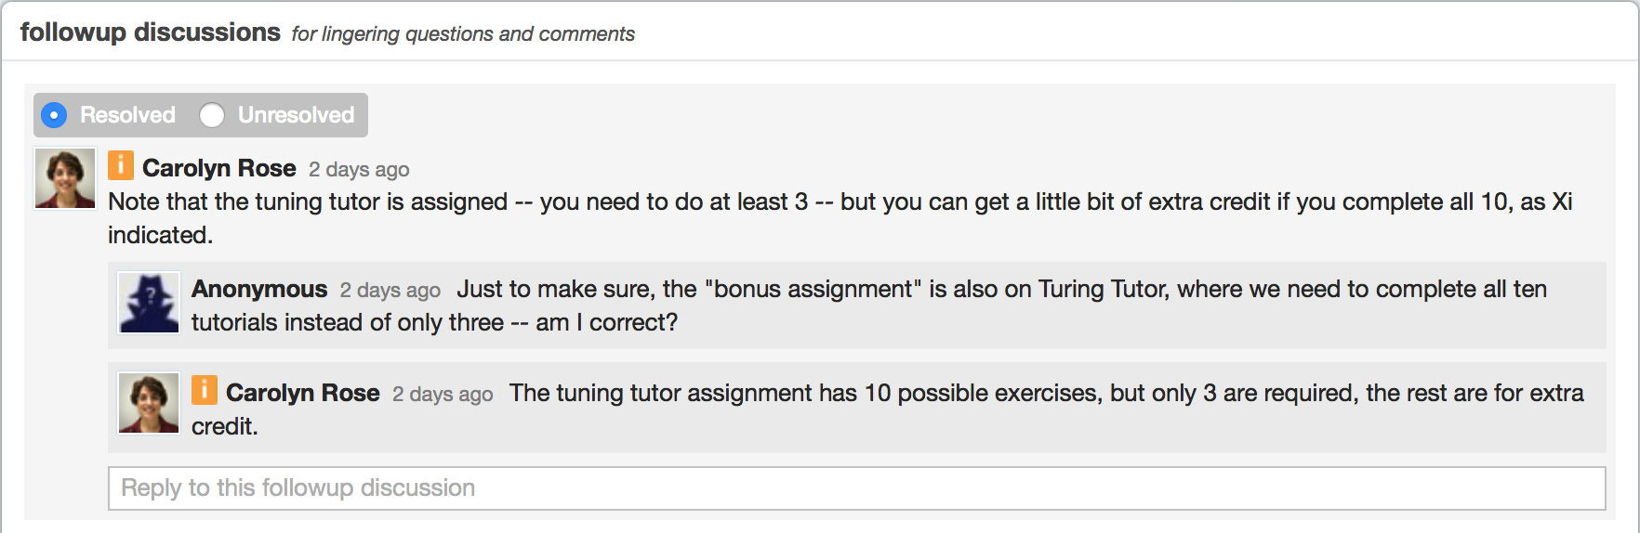
2b
2a
2h
2i
2i
1a

Slide 3
2d
2d
2d
Relations with Content
2c
2e
2g
2g
2g
2g
2g
2g
2f
2h
2j
2j
2i
1b

Slide 4
2d
Relations with DiscourseParts and between Contributions
2c
REPLY
2e
2g
REPLY
2g
REPLY
2f
2h
REPLY
2j
2i
1b

Slide 5
